Slide 1
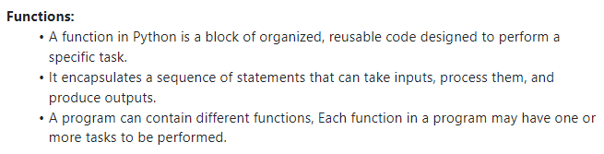
Functions in Python

Slide 2
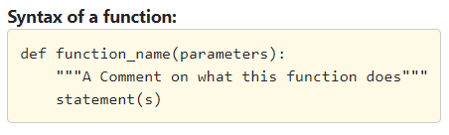
Syntax

Slide 3
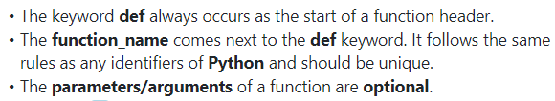
Contd…

Slide 4
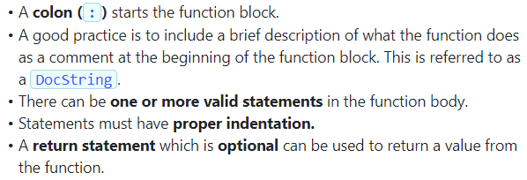
Contd…

Slide 5
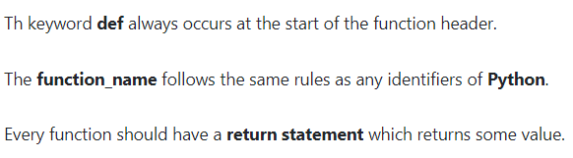
Select the correct option

Slide 6
Contd…
Answer: Option 1 & 2 are correct

Slide 7
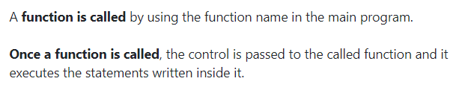
Contd…

Slide 8
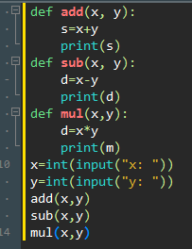
Example(1.4)

Slide 9
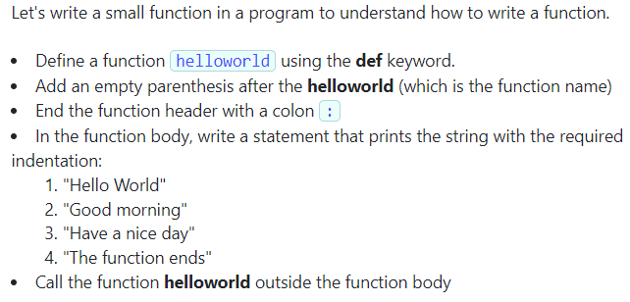
Problem statement(1.3)

Slide 10
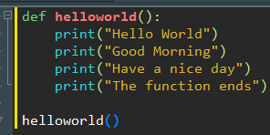
Contd…

Slide 11
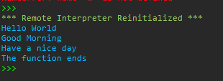
Output:

Slide 12
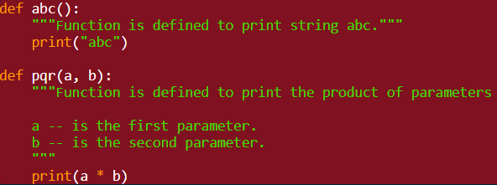
Understanding Docstring

Slide 13
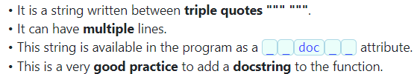
Features of docstring:

Slide 14
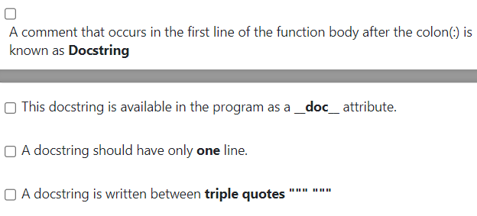
Select the correct option:

Slide 15
Contd…
Option 1,2 and 4 is correct.

Slide 16
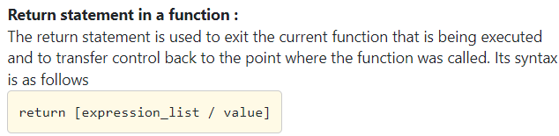
Return statement

Slide 17
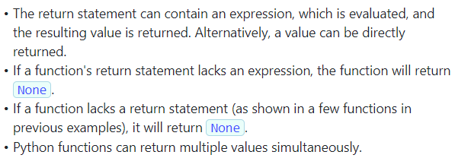
Features of Return statement

Slide 18

Problem statement(1.8)

Slide 19
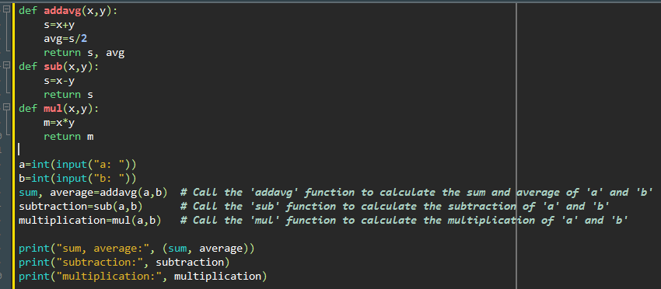
Contd…

Slide 20
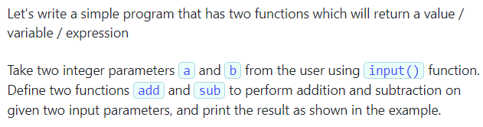
Problem statement(1.9)

Slide 21
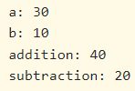
Contd… Sample Input & Output

Slide 22
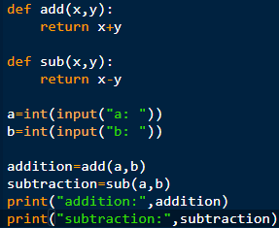
Contd…

Slide 23
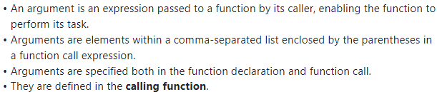
Arguments

Slide 24
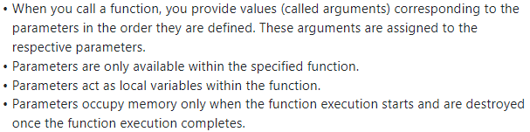
Parameters

Slide 25
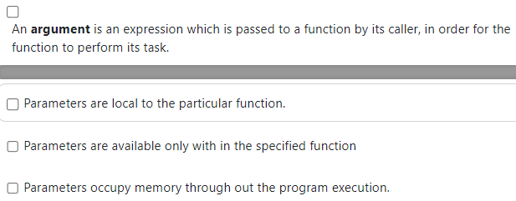
Select the correct option:

Slide 26
Option 1,2,3 are correct.

Slide 27
Note:
Parameters occupy memory when the function execution starts and are destroyed when the function execution completes.

Slide 28

Problem statement(2.2)

Slide 29
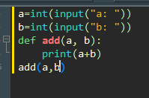
Contd…

Slide 30
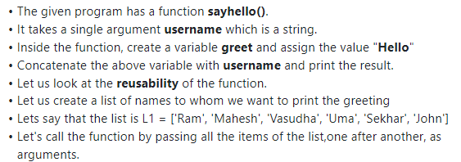
Example(2.3): Write this function:

Slide 31
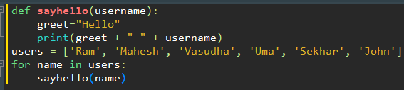
Contd…

Slide 32
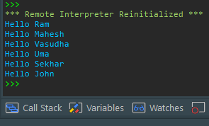
Contd…

Slide 33
Types of Arguments:
Positional Arguments
Keyword Arguments

Slide 34
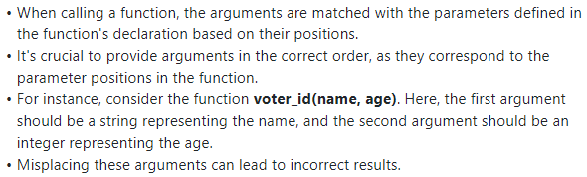
Positional Arguments

Slide 35
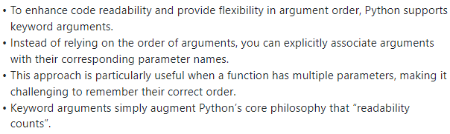
Keyword Arguments

Slide 36
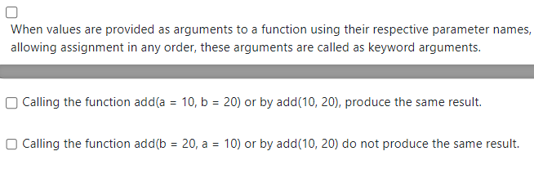
Select correct statements:

Slide 37
Option 1 & 2 are correct.

Slide 38
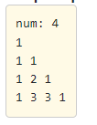
Write a program to print Pascal’s traingle as shown in the example: (using function)

Slide 39
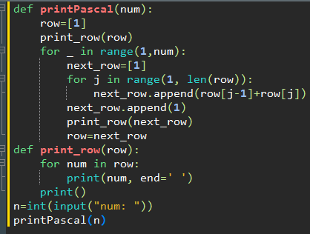
Contd…

Slide 40
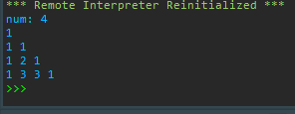
Contd…

Slide 41
Steps:
printPascal(num) : function takes one argument num, which represents the number of rows of Pascal's Triangle to generate and print.
It initializes a list row with a single element, 1, representing the first row of Pascal's Triangle.
It then calls the print_row(row) function to print the first row.
Next, it enters a loop that iterates num-1 times (one less than the specified number of rows to account for the first row that has already been printed).

Slide 42
Contd…
Inside the loop, it initializes a new list next_row with a single 1, representing the first element of the next row.
It then enters another loop that iterates through the elements of the row list (the previous row) starting from the second element (index 1) and calculates the sum of the current element and the element immediately before it. These sums are appended to the next_row list.

Slide 43
Contd…
After calculating and appending all the values for the current row, it appends a final 1 to the next_row list since the last element of every row in Pascal's Triangle is always 1.
It calls the print_row(next_row) function to print the current row.
Finally, it updates the row variable to be the next_row for the next iteration of the loop.

Slide 44
Contd…
The print_row(row) function is defined separately to print a given row. It takes a list row as input and iterates through its elements, printing each number with a space between them and a newline character at the end to move to the next row.
Outside of the function definitions, it prompts the user to enter the number of rows they want to generate (n) using the input() function.
It calls the printPascal(n) function with the user's input to generate and print the specified number of rows of Pascal's Triangle

Slide 45
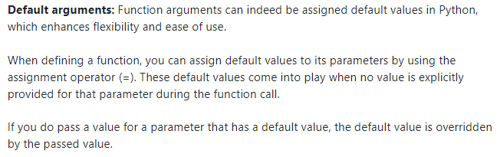
Default Arguments

Slide 46
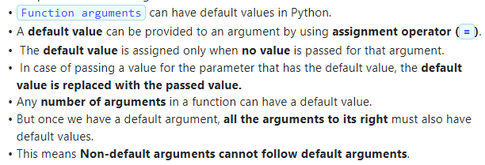
Contd… Key points:

Slide 47
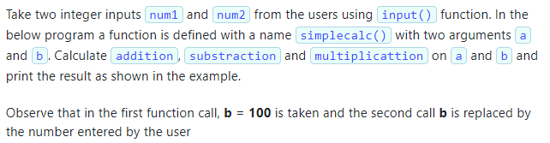
Problem statement(3.1)

Slide 48
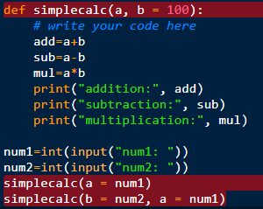
Contd…

Slide 49
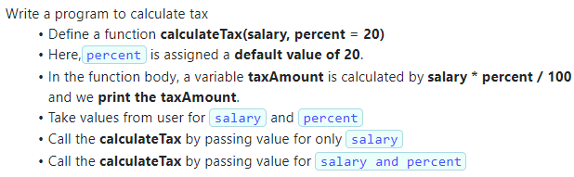
Problem statement(3.2)

Slide 50
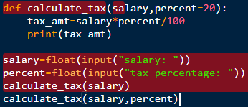
Contd…

Slide 51
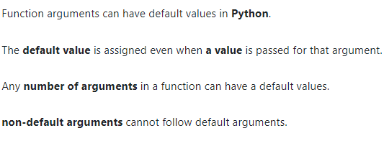
Select the correct statement

Slide 52
Option 1,3,4 are correct

Slide 53
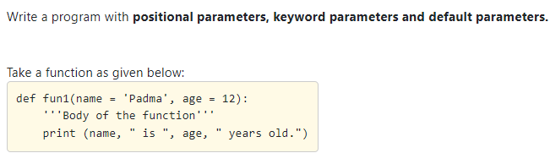
Problem statement(3.4)

Slide 54
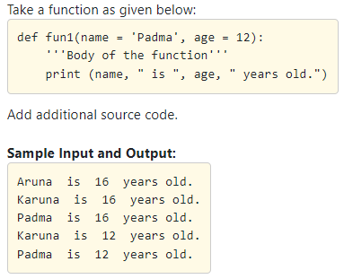
Contd…

Slide 55
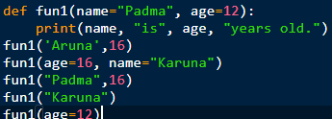
Contd…

Slide 56
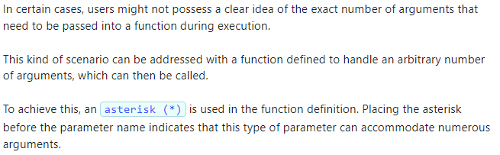
Arbitrary/ Variable Length Arguments:

Slide 57
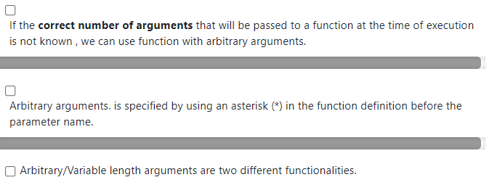
Select the correct statement:

Slide 58
Option 1 &2 are correct

Slide 59
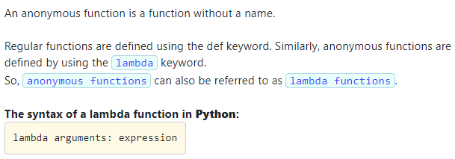
Anonymous functions

Slide 60
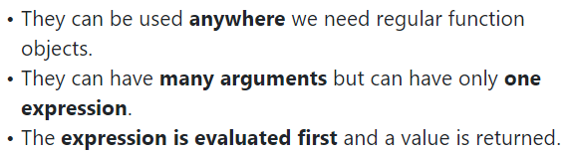
Features of Lambda Function

Slide 61
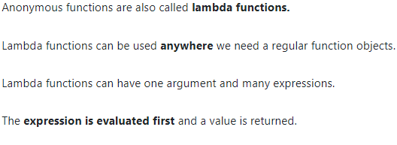
Select the correct option:

Slide 62
Option: 1,2,4 are correct

Slide 63
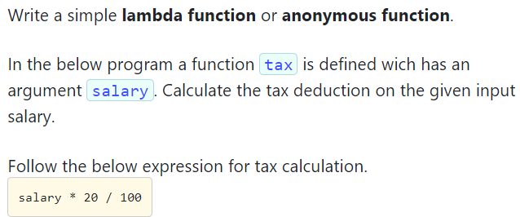
Problem statement(4.2)

Slide 64
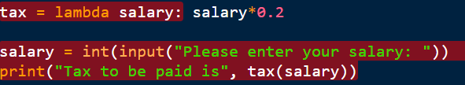
Contd…

Slide 65
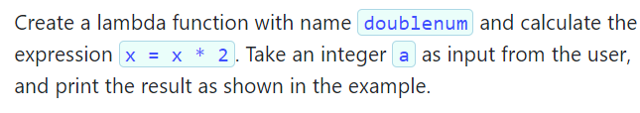
Problem statement(4.3)

Slide 66

Contd…

Slide 67


Understanding Map Function

Slide 68


Problem statement (4.4)

Slide 69

Contd…

Slide 70

Filter Function:-

Slide 71

Contd…

Slide 72

Problem statement(4.5)

Slide 73

Contd…

Slide 74

Fruitful Function

Slide 75

Select the correct option:

Slide 76
Option 1,2,3 are correct.

Slide 77

Local Variables

Slide 78


Problem statement(6.1)

Slide 79


Slide 80

Global Variables

Slide 81

Example

Slide 82


Follow these instructions and write the Python code(6.2)

Slide 83


Slide 84

Function Composition

Slide 85


Follow these instructions, and write the Python code(6.1)

Slide 86


Slide 87

Recursion

Slide 88

Contd…

Slide 89

Select the correct option

Slide 90
Option 1,3 are correct.

Slide 91

Types of Recursion

Slide 92

Important points:

Slide 93

Select the correct option

Slide 94
Option 2 is correct.

Slide 95


Problem statement(7.3)

Slide 96


Slide 97

Creation of Modules

Slide 98

Disadvantages of modules

Slide 99

Select the correct option

Slide 100
Option1,2,4 are correct.

Slide 101


Problem statement(9.3)

Slide 102


Slide 103

Import statement/ Importing a module(10.1)

Slide 104


Slide 105


Problem statement(10.2)

Slide 106


Slide 107

Import using ‘as’ keyword

